Slide 1



Error uploading image.
Advanced Optimization System
By leverage the power of real-time data, advanced algorithms, and predictive analytics to transform our operations and gain a competitive edge.

Slide 2

Overcome Operational Challenges
Increased Costs
Productivity Losses
Resource Wastage
Reduce operational expenditures through optimized resource allocation.
Enhance workflows and streamline processes for maximum efficiency.
Minimize waste and improve utilization of assets and personnel.

Slide 3
Optimize Across Domains
Logistics
Manufacturing
Healthcare
Enhance transportation and distribution networks.
Optimize production lines and resource allocation.
Streamline medical supply chain and inventory management.

Slide 4
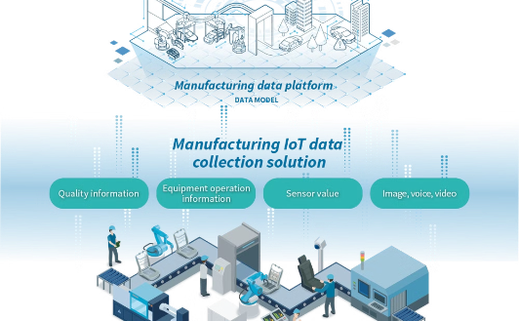
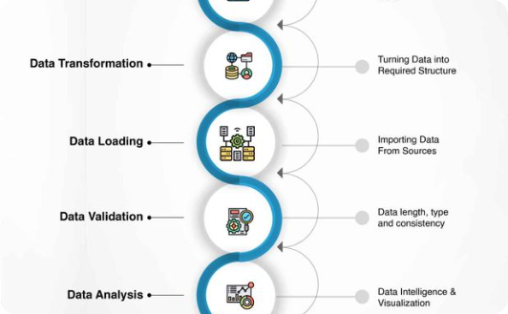

Harness Real-Time Data
Data Collection
Data Validation
Predictive Models
Integrate real-time data from IoT devices, sensors, and enterprise systems.
Ensure data accuracy and consistency through advanced cleansing techniques.
Leverage predictive analytics to forecast future trends and optimize decisions.

Slide 5
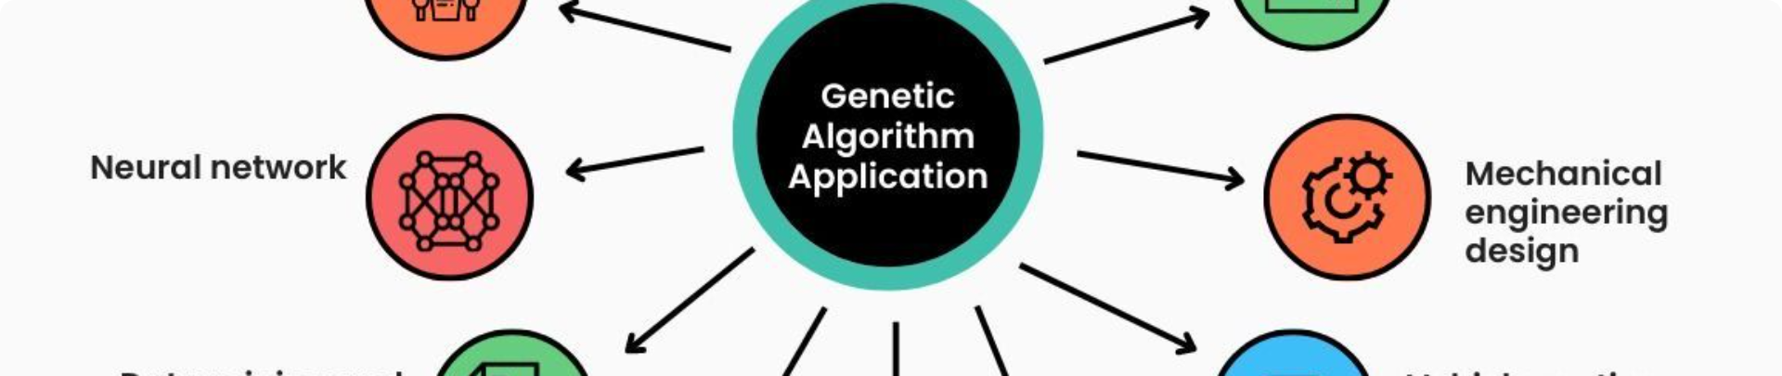
Intelligent Optimization Algorithms
1
Genetic Algorithms
2
Ant Colony Optimization
3
Particle Swarm Optimization
Evolve optimal solutions through selection, crossover, and mutation.
Mimic the natural behavior of ants to find the best resource allocation.
Leverage the collective intelligence of a swarm to optimize workflows.

Slide 6


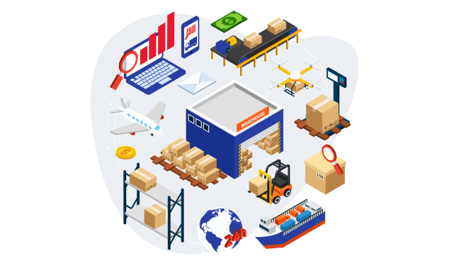


Streamline Workflows
Resource Allocation
Intelligently assign and manage resources for maximum efficiency.
Bottleneck Elimination
Identify and address operational bottlenecks to improve throughput.
Continuous Improvement
Leverage feedback loops to refine processes and enhance performance.

Slide 7





Error uploading image.
Gain Actionable Insights
Real-Time Monitoring
Continuously track operational metrics and identify areas for improvement.
Predictive Analytics
Forecast future trends and make data-driven decisions.
Performance Reporting
Generate comprehensive reports to measure and optimize operations.

Slide 8
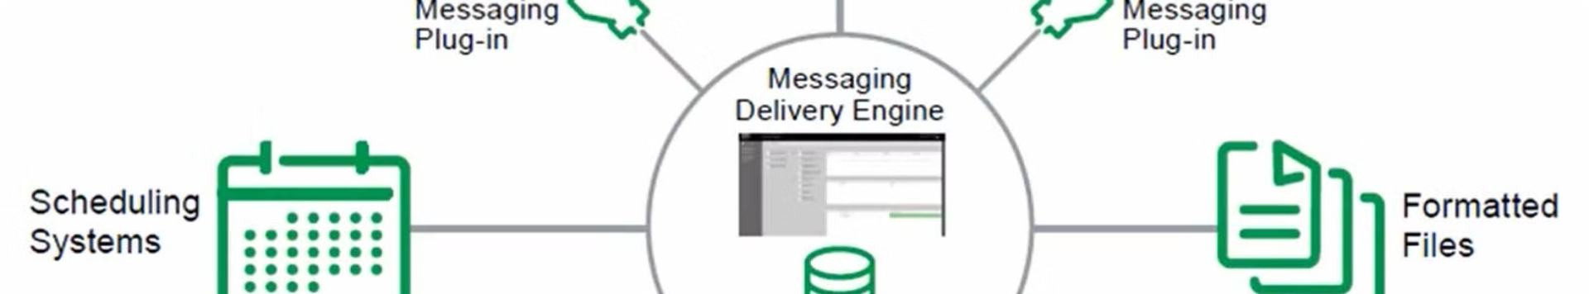
Unify Optimization Efforts
Data Collection
Optimization Algorithms
Predictive Analytics
Resource Allocation
Monitoring and Reporting
Seamlessly integrate real-time data from multiple sources.
Apply advanced optimization techniques to find the best solutions.
Leverage predictive models to anticipate future needs and trends.
Intelligently assign and manage resources for optimal efficiency.
Track performance, generate insights, and continuously improve operations.

Slide 9


Transformational Benefits
Reduced Costs
Significantly lower operational expenditures through optimized resource utilization.
Increased Productivity
Enhance workflows and eliminate bottlenecks for maximum output.
Improved Decision-Making
Make data-driven decisions based on real-time insights and forecasts.
Competitive Advantage
Gain a distinct edge in the market by adopting advanced optimization technologies.

Slide 10


Unlock The Full Potential
By unleashingof the Advanced Optimization System to transform your operations and unlock unprecedented efficiency, productivity, and profitability.

